Slide 1
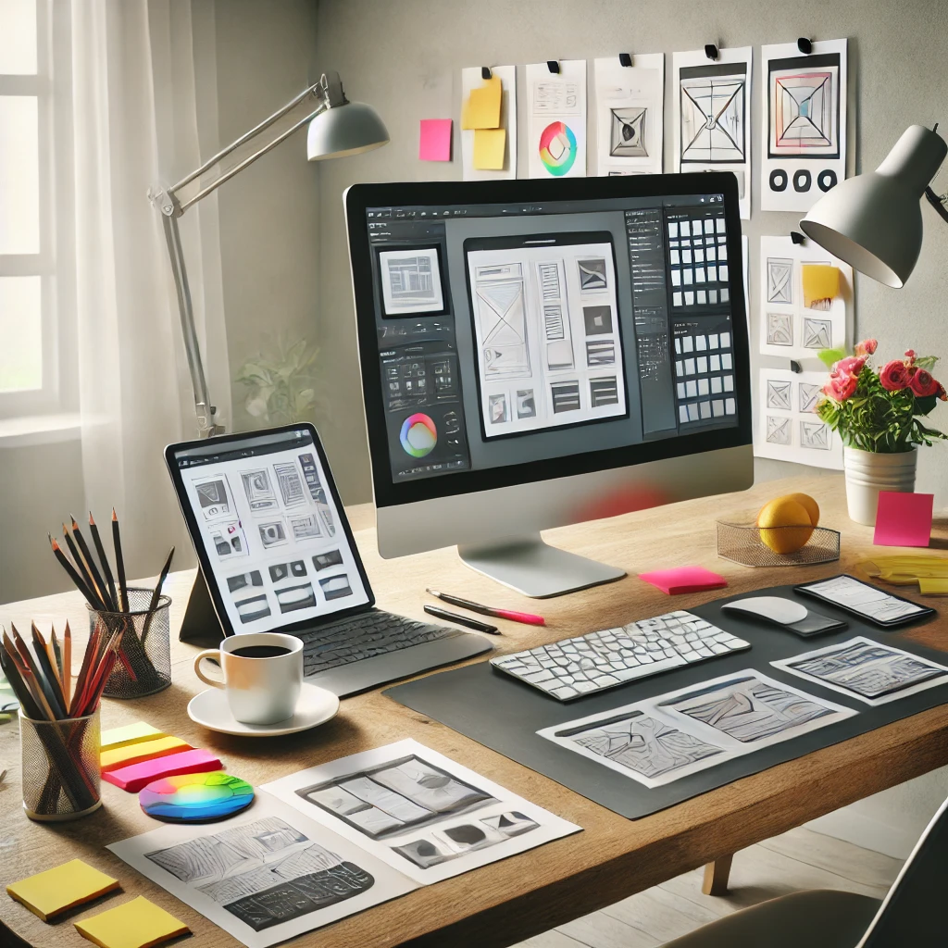
Visualization and Prototyping
Submitted By:
Aayush Raj Patrabansh
Krish Khanal
Samarpan Karki
Date: 13/08/2024

Slide 2
Introduction to Visualization
Importance of Prototyping
Types of Visualization
Prototyping Tools and Techniques
Best Practices
Overview of Presentation

Slide 3
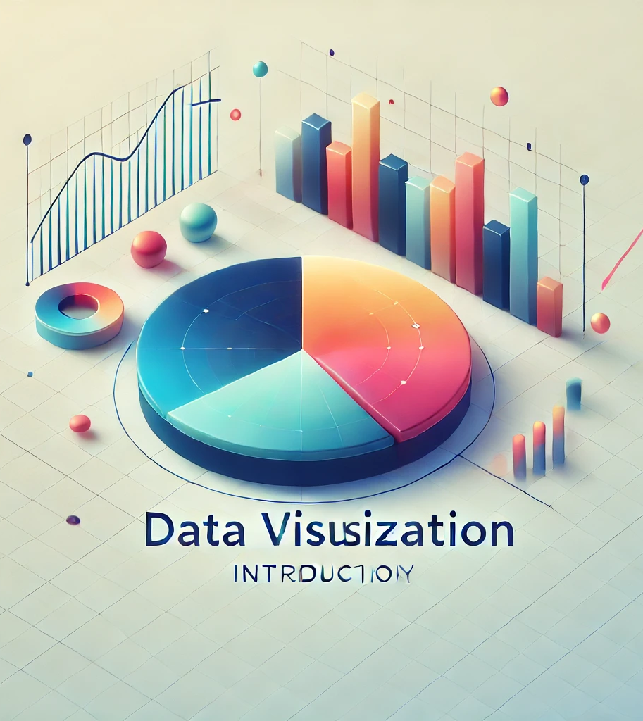
Introduction to Visualization
In product design, visualization is the process of creating images, models, or diagrams to represent ideas, concepts, or designs visually. It plays a crucial role in conveying complex ideas clearly and effectively, allowing team members, stakeholders, and users to understand the design intentions. Clear visualization ensures alignment and reduces misunderstandings, which is essential for efficient and successful product development.

Slide 4

Benefits of Visualization
Using visualization techniques in product design offers several advantages: it enhances communication with stakeholders by making ideas accessible, improves understanding of design concepts for all team members, aids efficient problem-solving by quickly identifying issues, and minimizes misunderstandings and errors, ultimately streamlining the development process.

Slide 5
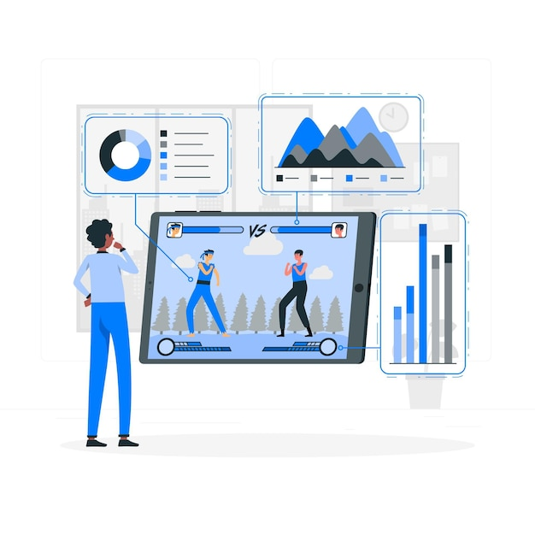
Types of Visualization
Sketches and Concept Drawings: Quick, rough visuals to explore ideas and establish the basic look or function of a product.
Wireframes and Mockups: Digital layouts that outline structure and functionality, often used for UI/UX design.
Storyboards and User Flows: Visual narratives that show how users interact with a product over time, highlighting key interactions.
3D Modeling and Rendering: Realistic visuals that depict the final product’s form and appearance, ideal for physical products.
Data Visualization: Graphs and charts that present user data, insights, or performance metrics for informed design decisions.

Slide 6
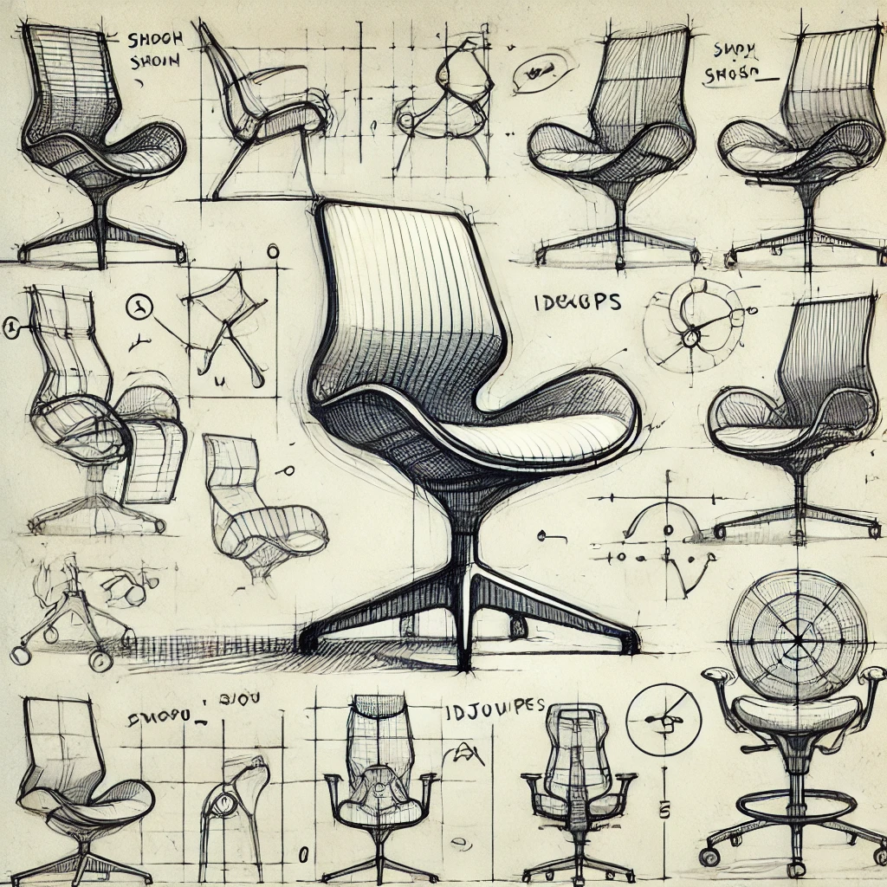
Sketches and Concept Drawings
Sketches and concept drawings are valuable in early design stages as they quickly capture ideas, allow for exploration of multiple concepts, and facilitate easy communication among team members, helping shape the initial direction of a product.
Hand-drawn sketches are crucial in early idea generation, quickly visualizing concepts without detail commitment. For instance, a designer might sketch various ergonomic chair ideas, exploring shapes and features to refine concepts effectively, as shown in the example image.

Slide 7
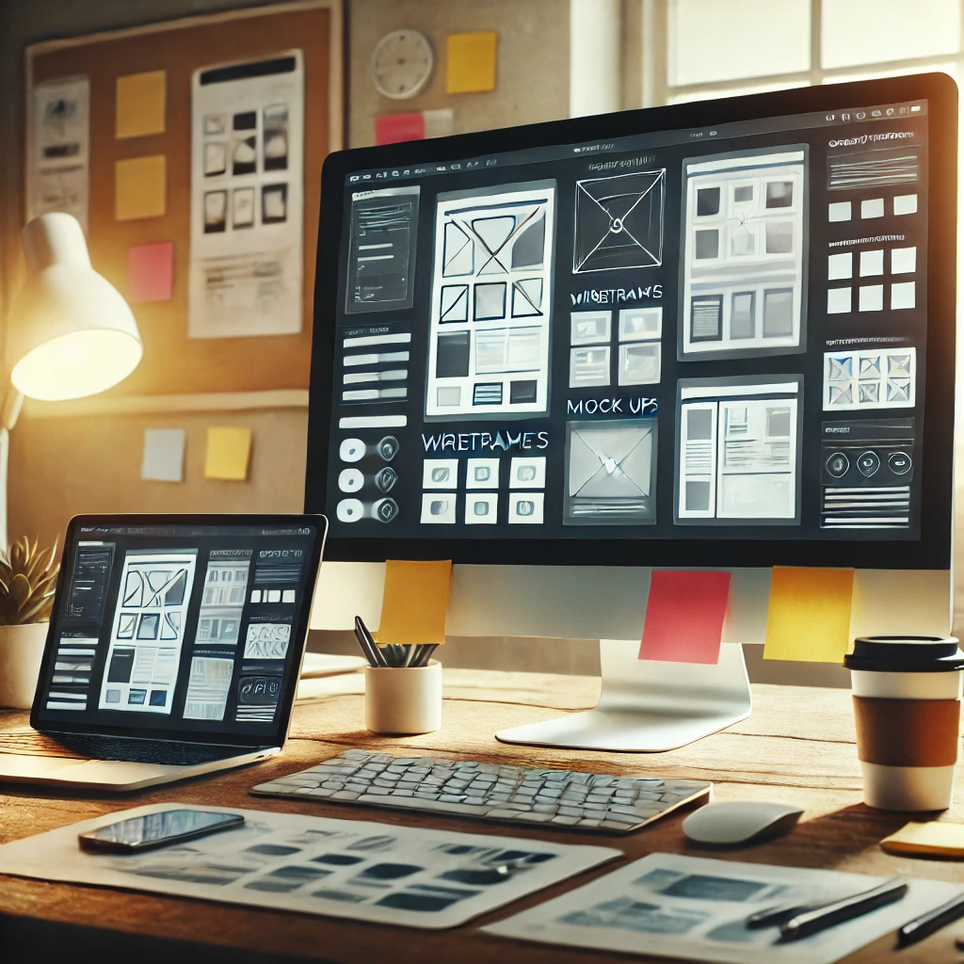
Wireframe and Mockups
Wireframes and mockups serve as low-fidelity design tools to outline the basic structure (wireframes) and more detailed visuals (mockups) of a digital product. They allow designers to test layout, functionality, and aesthetics without full development. Gathering user feedback at each stage helps refine the designs, ensuring usability and alignment with user needs before progressing to high-fidelity prototypes.

Slide 8
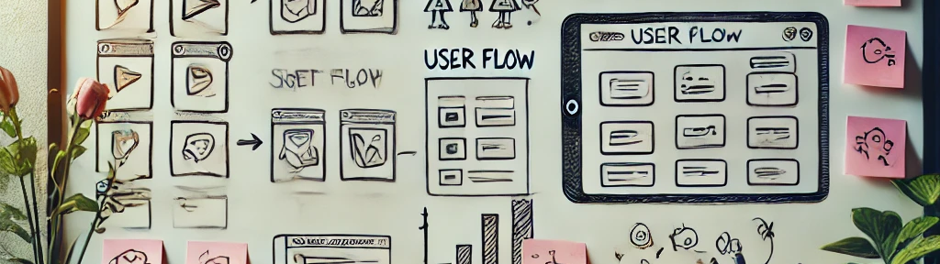
StoryBoards and User Flows
Storyboards and user flows visually map user experiences by showing step-by-step interactions within a product. Storyboards illustrate key moments, like logging in, browsing, and checking out in an app, helping designers understand and optimize the user journey. User flows use diagrams to show decision points and paths, ensuring smooth navigation and logical progression.

Slide 9

3D Modeling and Rendering
3D modeling and rendering are essential for product visualization as they create realistic, detailed images of a product before it's built. This process helps designers and stakeholders assess design, materials, and functionality, making it easier to make adjustment, showcase concepts, and support marketing efforts.
Blender, a popular 3D modeling software, is widely used in product design for creating detailed models, simulating textures, and rendering realistic visuals. It allows designers to experiment with form, materials, and lighting, making it ideal for refining prototypes and presenting polished, lifelike product concepts.

Slide 10
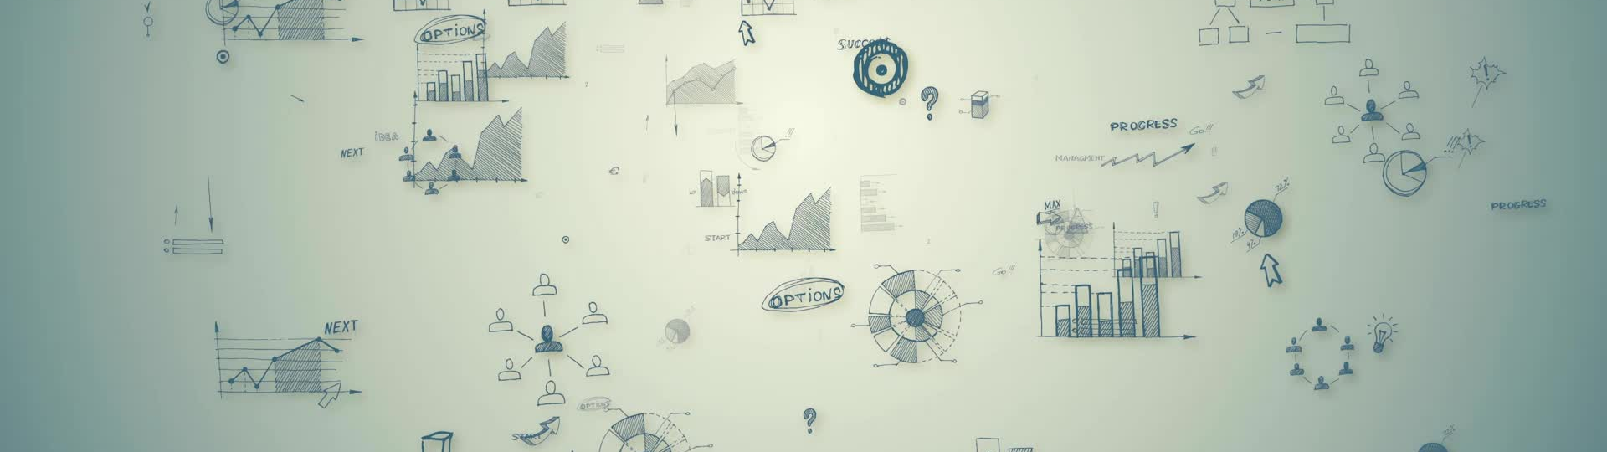
Data Visualization
In Jira, data visualization plays a crucial role in simplifying complex project information, making it easier for teams to understand, analyze, and act on data. By using tools like Jira Dashboards and Jira Reports, teams can turn extensive project metrics into visual insights. For example, burndown charts help track work completion against time, highlighting progress toward sprint goals, while velocity charts show the team's capacity over multiple sprints, assisting in future planning. Techniques like bar charts and line charts can visualize issue resolution rates over time, and pie charts reveal task distribution by status or assignee. These visualizations empower teams to quickly identify bottlenecks, monitor project health, and make informed decisions, enhancing communication and efficiency.

Slide 11

Introduction to Prototyping
Prototyping is the process of creating an early model or sample of a product to test ideas, design, and functionality. It plays a crucial role in product development by allowing teams to identify and resolve issues, gather feedback, and refine concepts before full-scale production, ultimately saving time and resources.

Slide 12

Importance of Prototyping
Iterative Development: Allows for continuous refinement through repeated testing and improvement cycles.
User Feedback and Testing: Provides real-time insights into user needs and usability, ensuring a user-centered design.
Risk Reduction: Identifies and resolves potential issues early, reducing the chance of problems later-on.
Cost Savings: Prevents costly changes in later stages by catching flaws early in development.

Slide 13
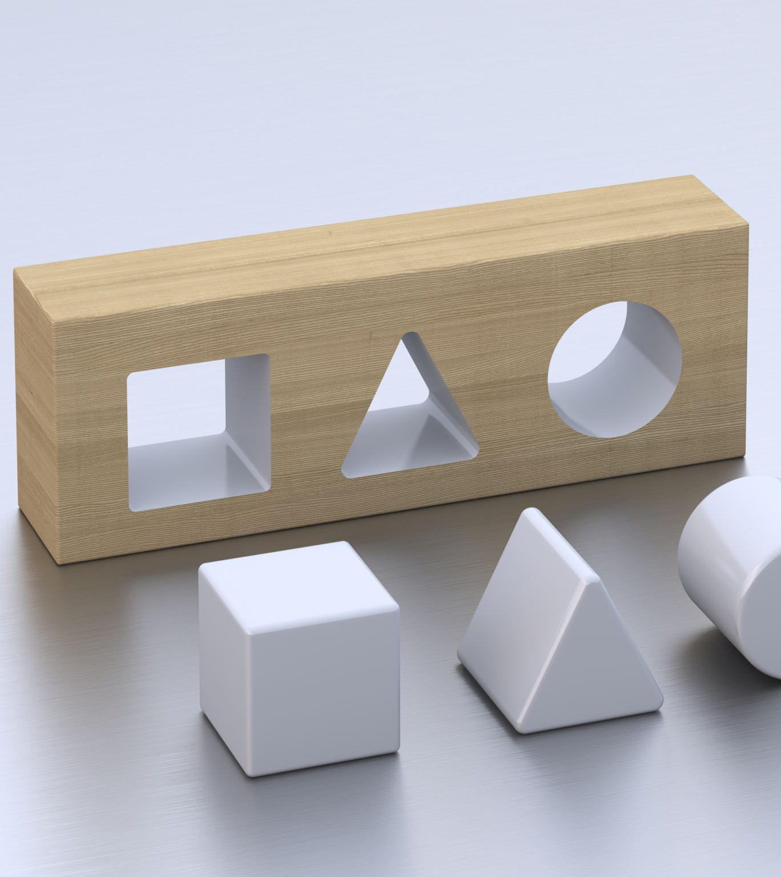
Types of Prototypes
Paper Prototypes: Simple, hand-drawn sketches used to visualize initial ideas and gather quick feedback.
Interactive Prototypes: Clickable, digital models that simulate user interactions to test workflows and usability.
Functional Prototypes: Early versions with limited functionality, allowing testing of specific features or technical feasibility.
High-Fidelity Prototypes: Detailed, near-complete models that closely resemble the final product, ideal for testing design and user experience before launch.

Slide 14
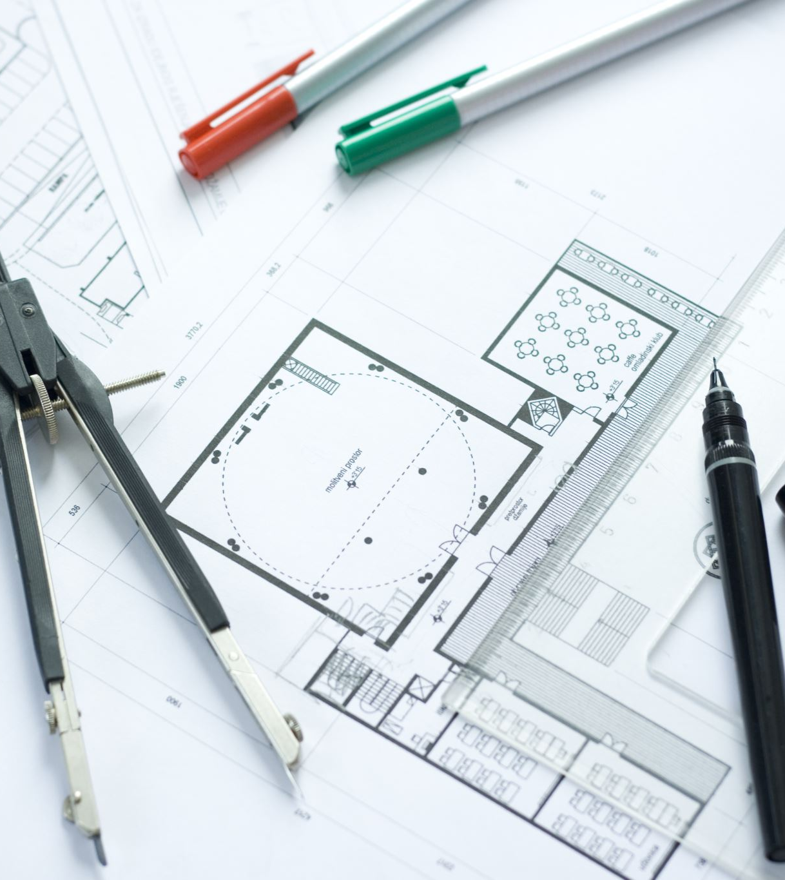
Prototyping Tools and Techniques
Paper and Pencil Prototyping: A quick, low-cost technique for sketching ideas on paper, allowing teams to visualize concepts and gather immediate feedback before moving to digital formats.
Digital Prototyping: Tools like Figma, Sketch, and Adobe XD enable interactive, high-fidelity prototypes, allowing designers to test user flows, functionality, and visual elements in a digital environment.
3D Printing and Rapid Prototyping: This approach creates physical models to test product shape, fit, and functionality, ideal for tangible products where real-world interaction and ergonomics are essential.

Slide 15
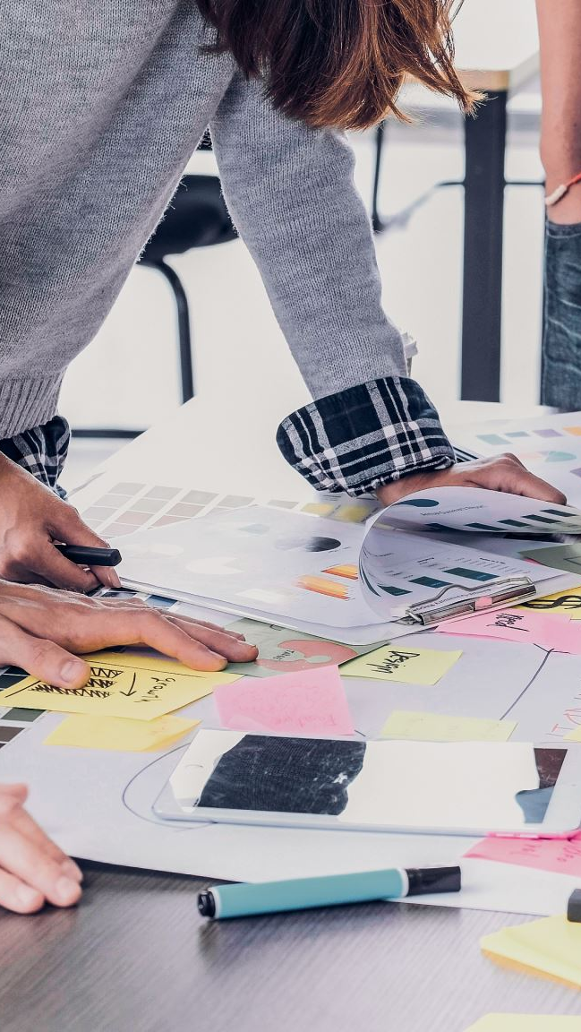
Best practices for effective Visualization and Prototyping
Involve Stakeholders Early and Often: Engage team members, clients, and stakeholders from the beginning to ensure alignment, gather insights, and avoid costly revisions later.
Keep Prototypes Simple and Focused: Start with low-fidelity prototypes to convey key ideas without overloading with detail; gradually increase complexity as ideas solidify.
Gather User Feedback and Iterate: Continuously test prototypes with real users, using their feedback to refine and improve designs iteratively.
Document and Version Control Your Work: Track changes, maintain clear documentation, and use version control tools to manage updates and ensure consistency across project stages.

Slide 16
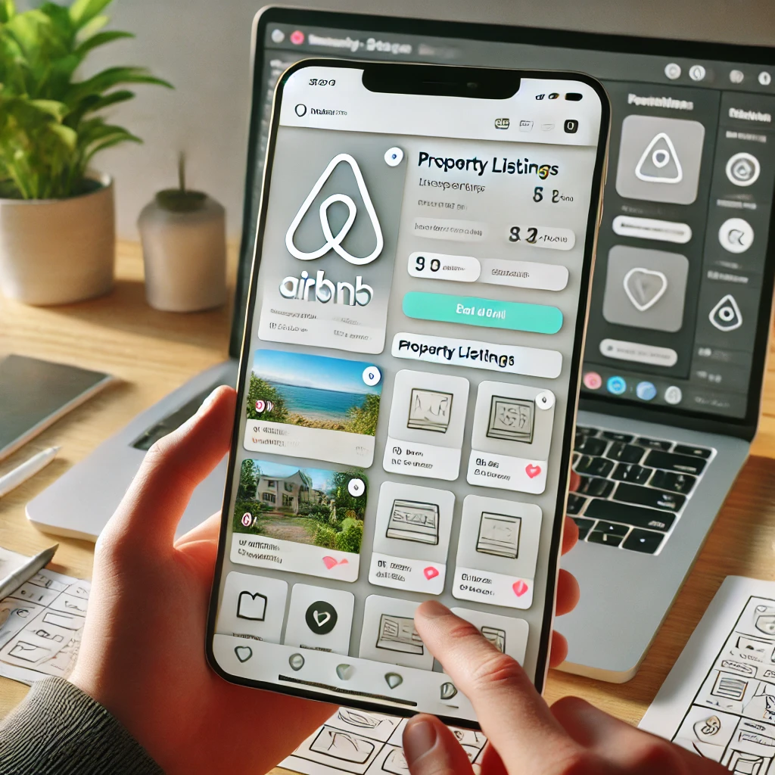
Case Studies
A well-known example of visualization and prototyping in product design is Airbnb’s success with Sketch and rapid prototyping. Early in their journey, Airbnb faced challenges with user experience (UX) and user interface (UI) design. To improve, they used Sketch and other prototyping tools to quickly create and test visualizations of new ideas. By prototyping and gathering user feedback early, they significantly improved their platform’s usability, leading to higher user satisfaction and a more seamless booking process. This iterative process enabled Airbnb to make swift adjustments before full implementation, saving time and resources while enhancing user engagement.

Slide 17
Conclusion
Visualization and prototyping are vital tools in product design, enhancing communication, refining ideas, and streamlining development. Through sketches, wireframes, and prototypes, designers can translate concepts into clear, interactive representations, minimizing misunderstandings and gathering valuable user feedback early. Prototyping, especially in iterative formats, helps identify risks and reduce costs, bridging the gap between initial ideas and polished products. This process not only improves product usability and user satisfaction but also supports a more efficient, collaborative development journey.

Slide 18
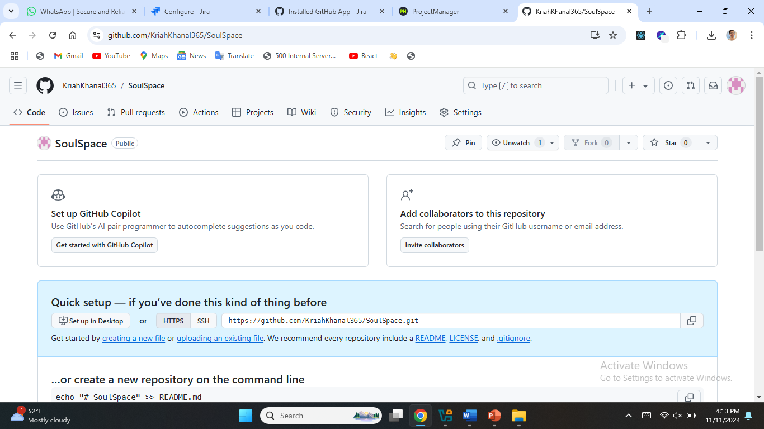
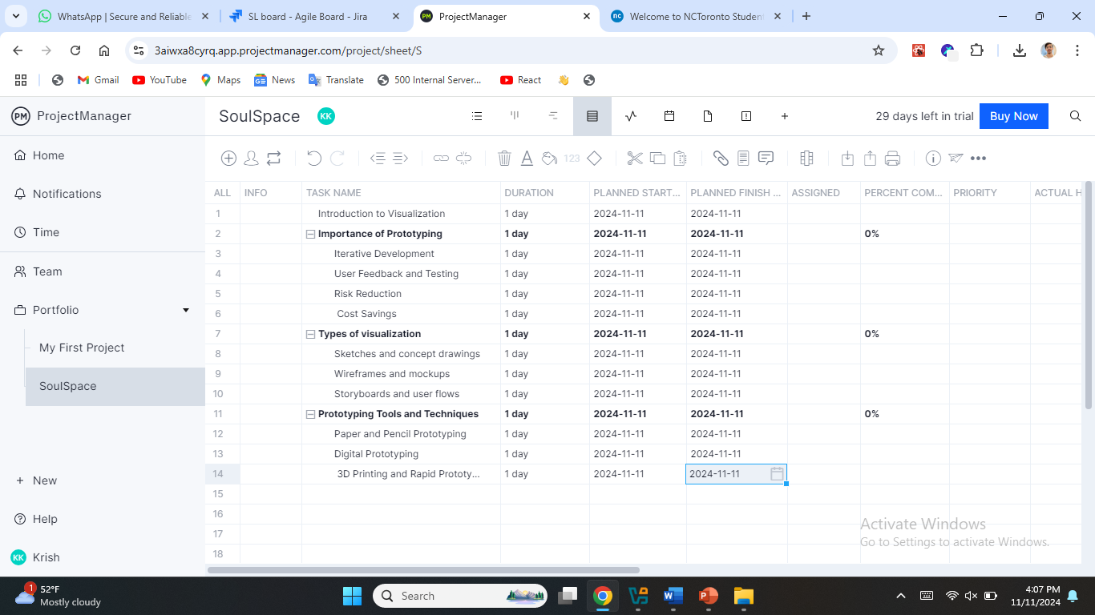

Slide 19
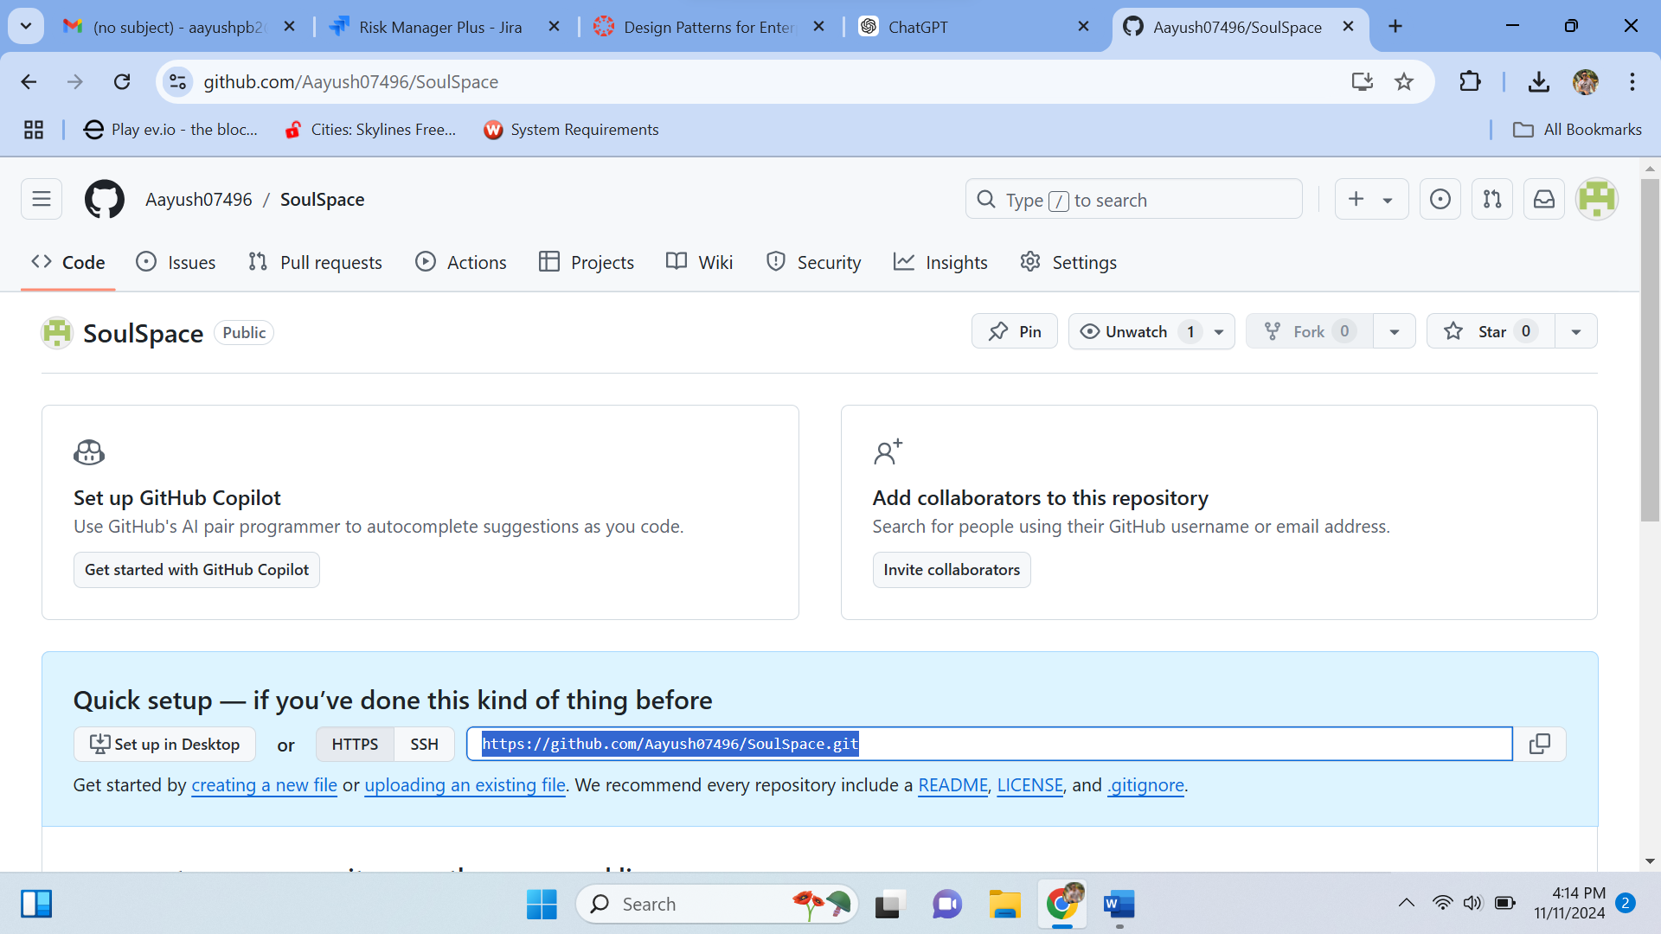
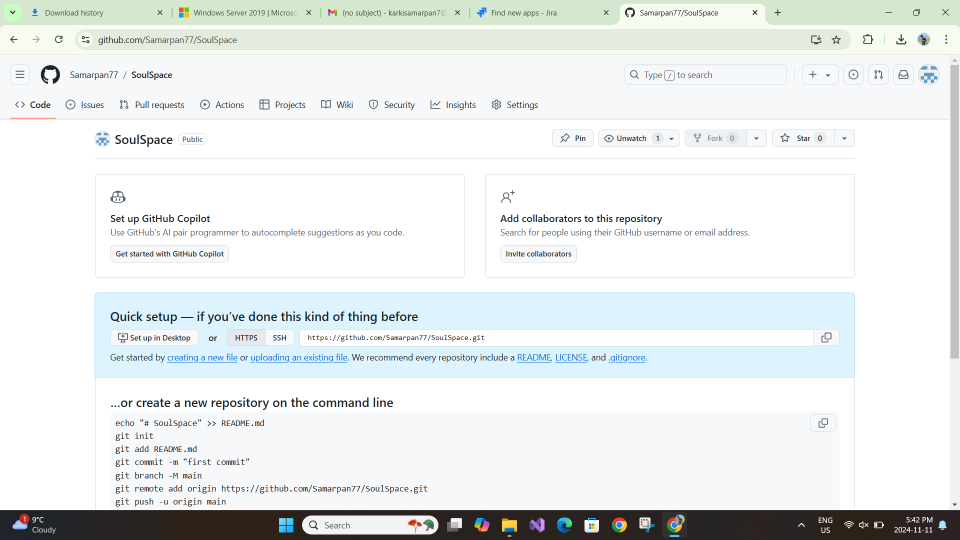

Slide 20
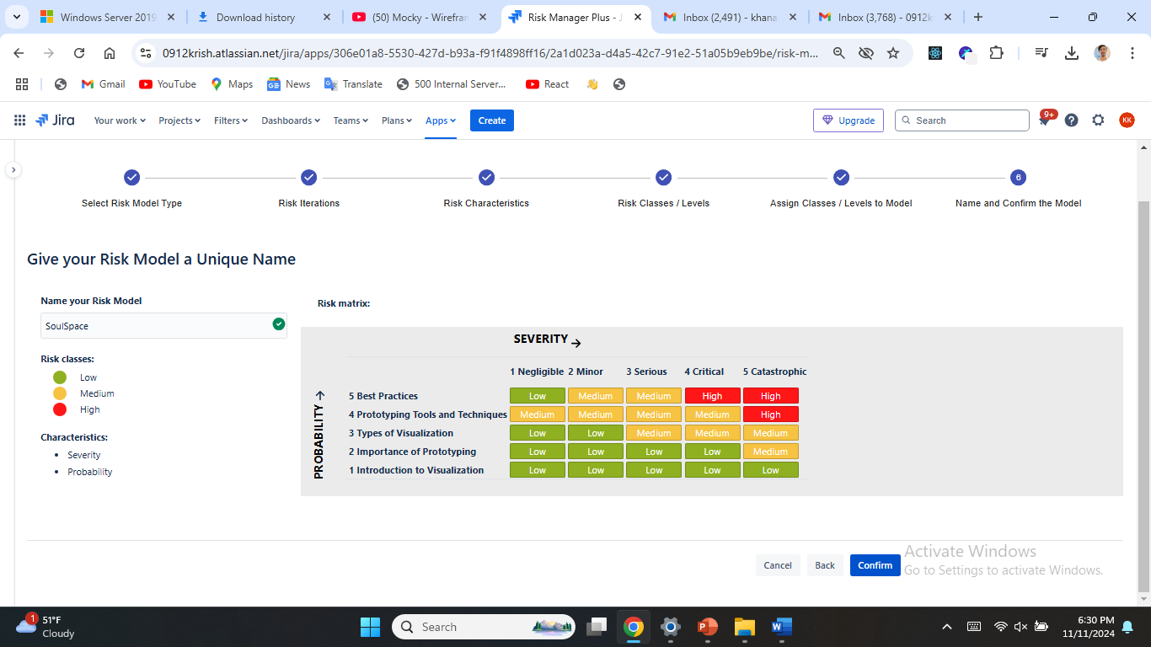
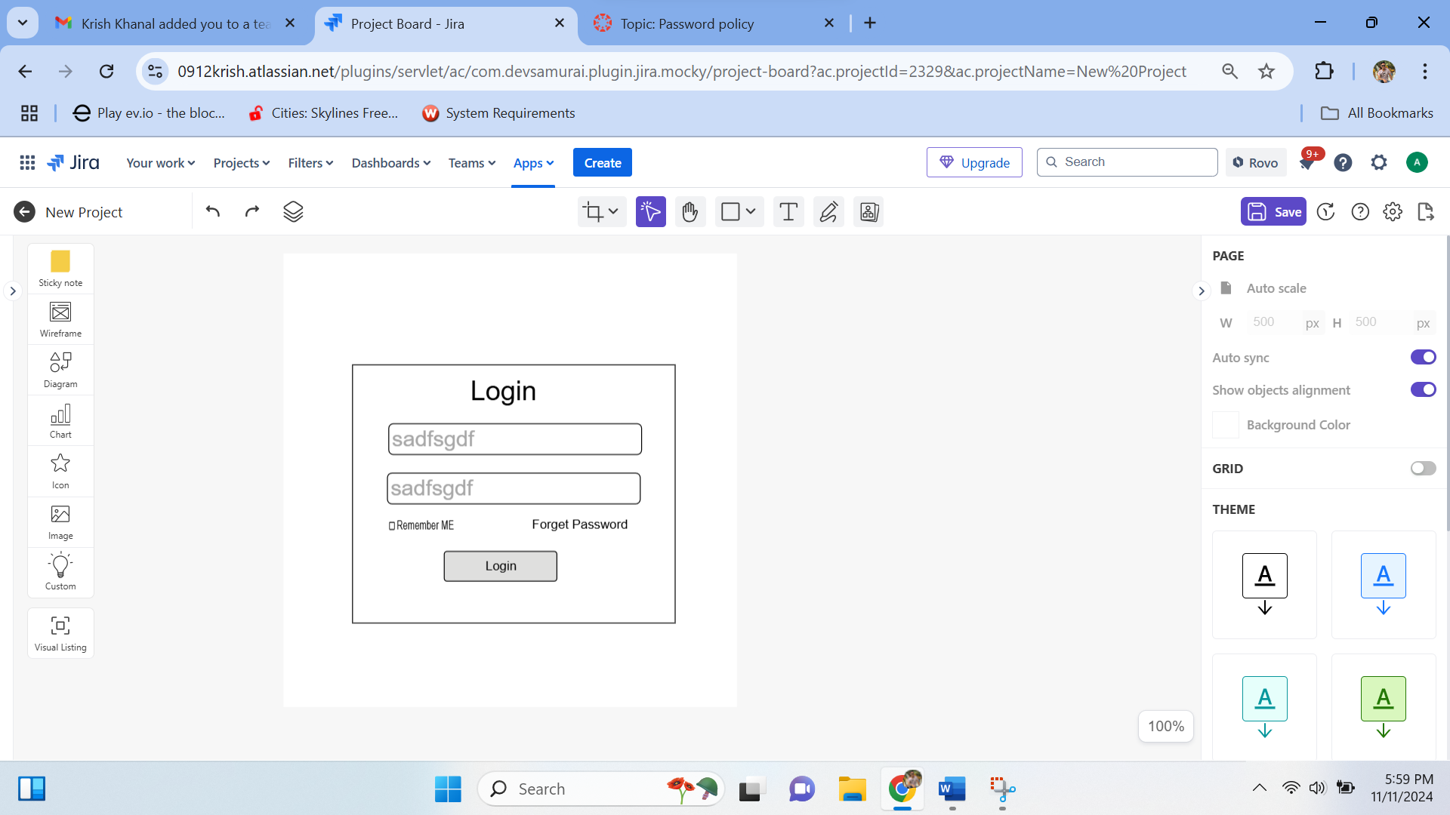
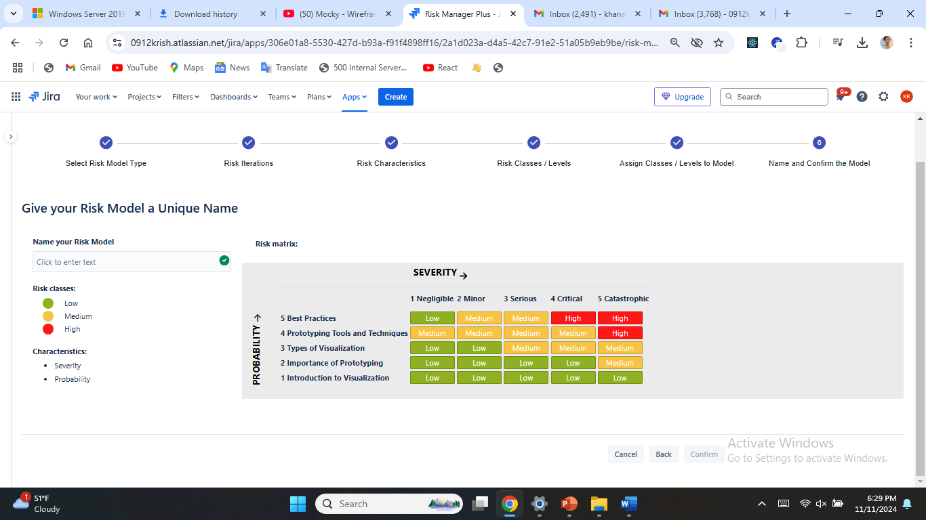
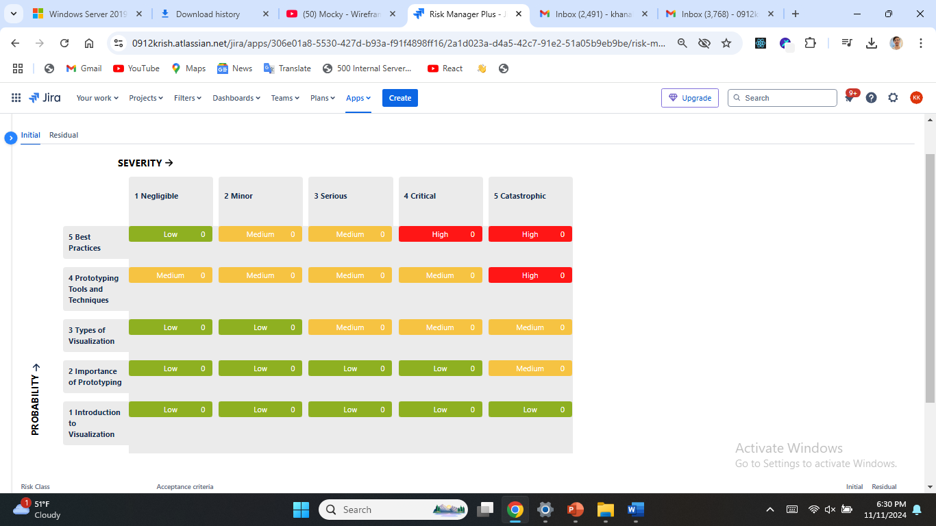

Slide 21
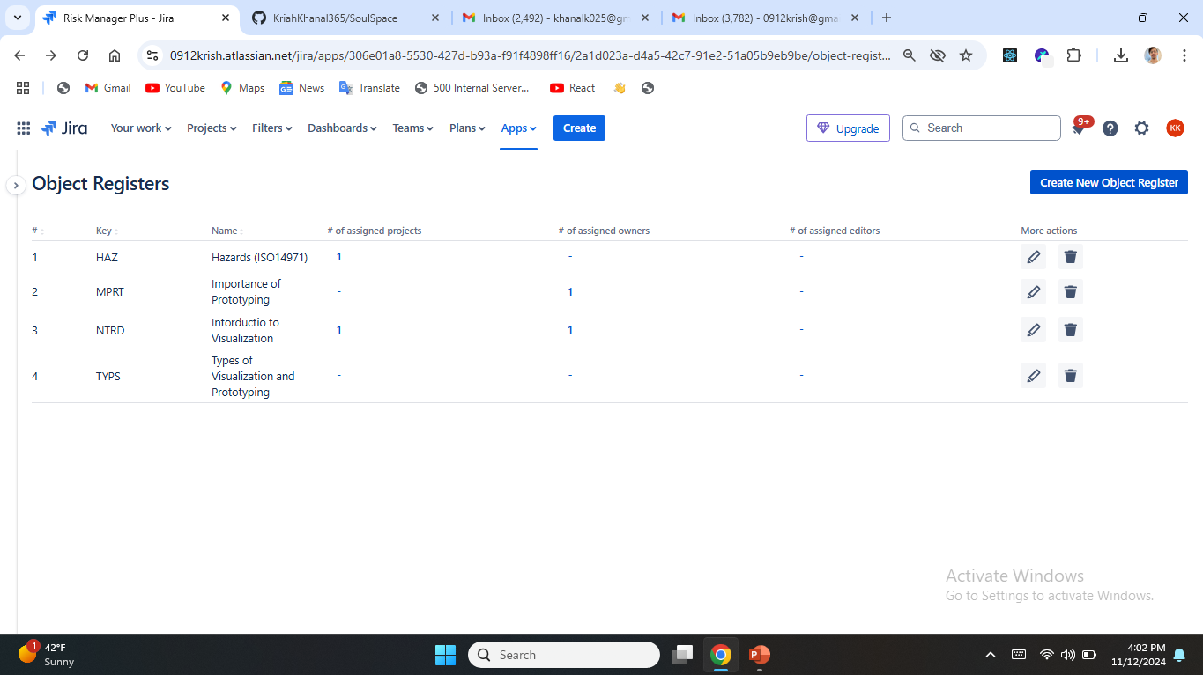
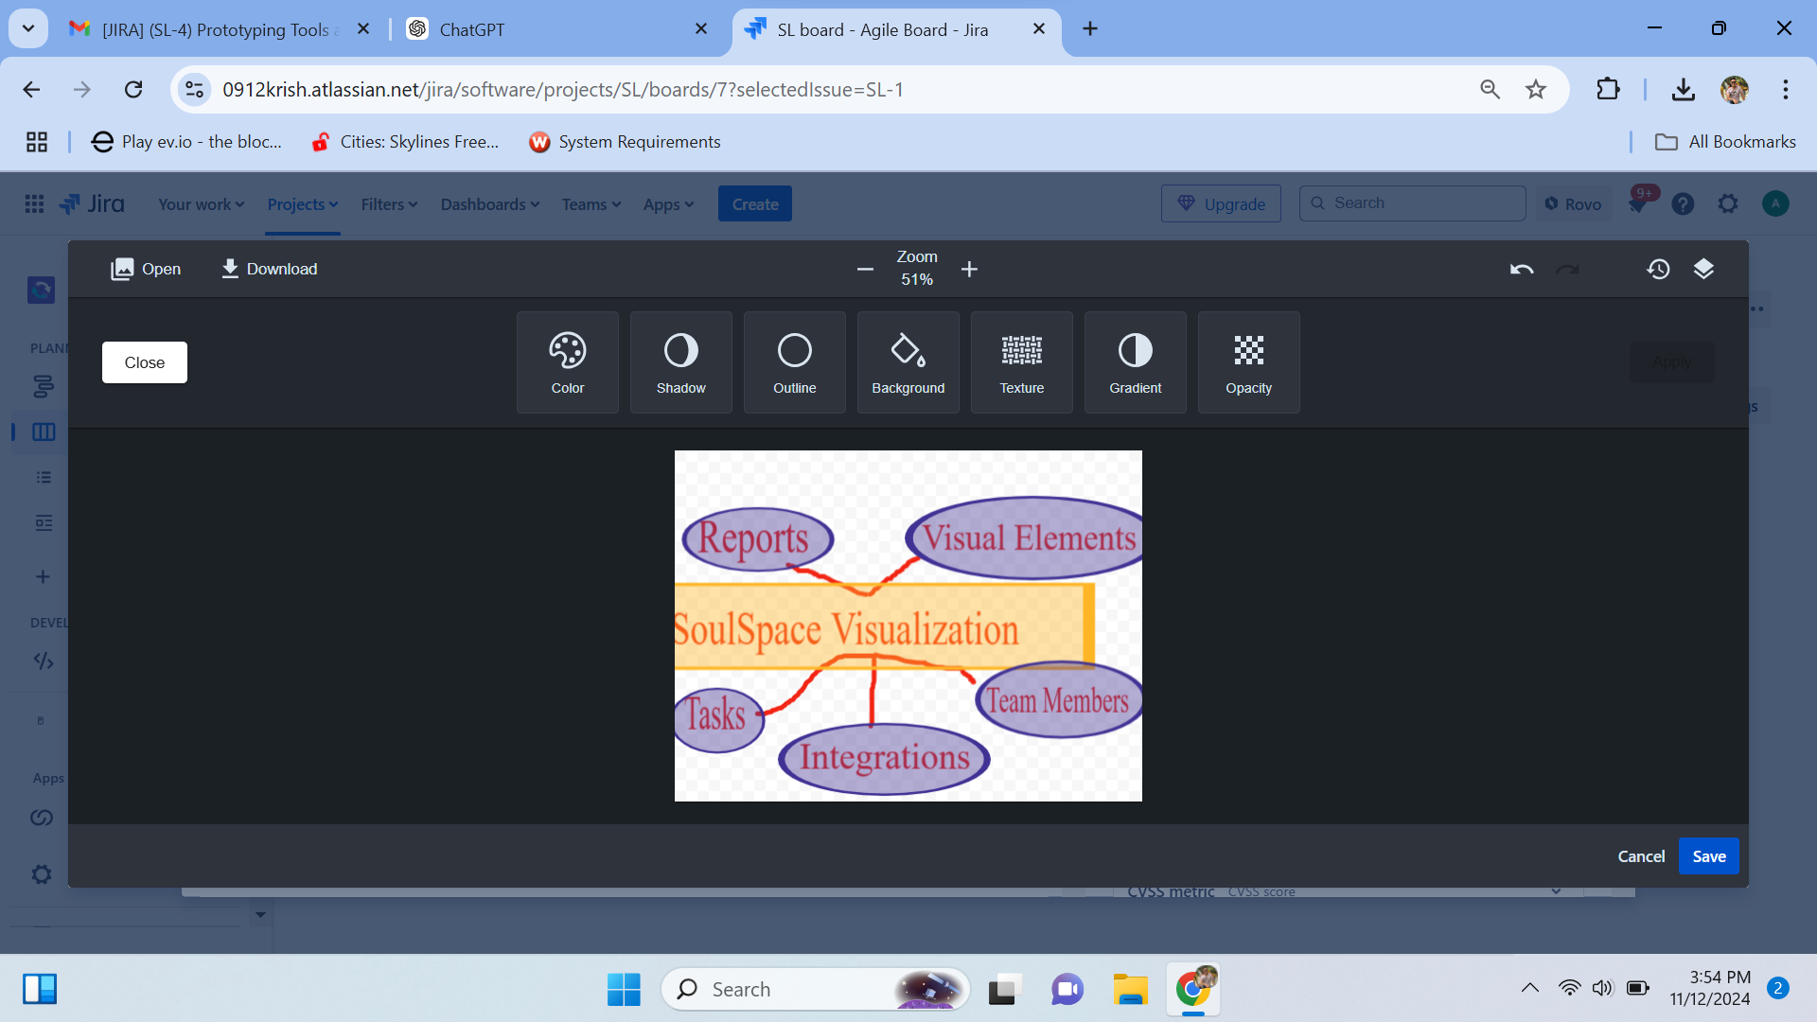

Slide 22
Any Questions ?

Slide 23

Thank You!

